Slide 1
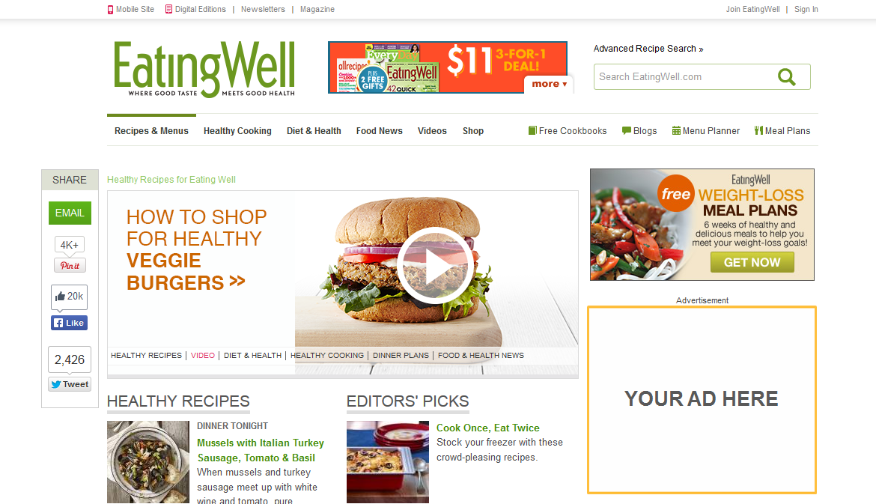
AUDIENCE TARGETING
Mock-Up Screenshot
Advertiser ::
Date ::
Site ::
Creative Size ::

Slide 2
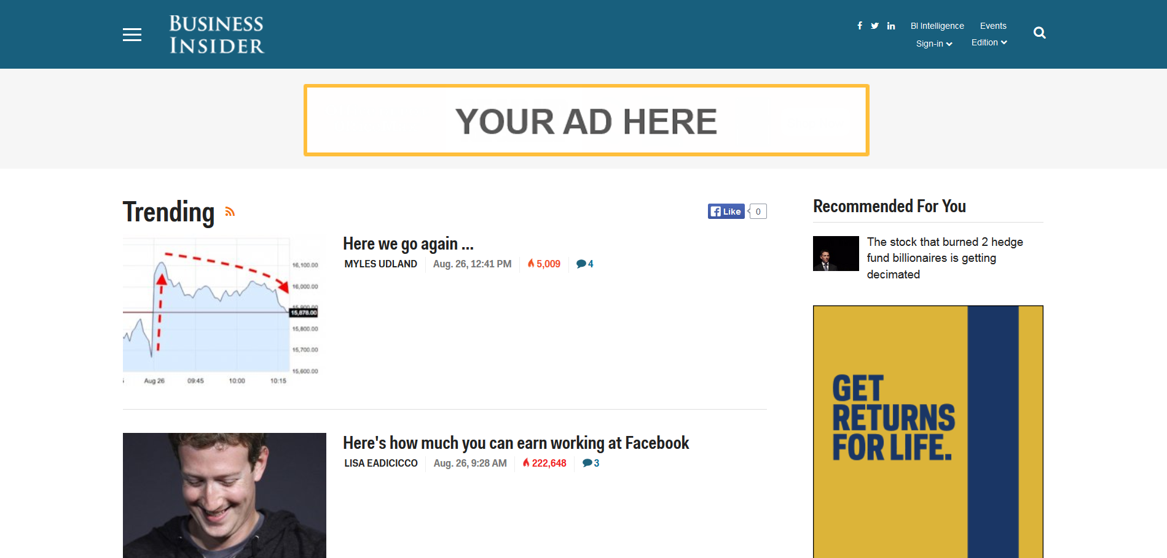
RUN OF NETWORK TARGETING
Mock-Up Screenshot
Advertiser ::
Date ::
Site ::
Creative Size ::

Slide 3
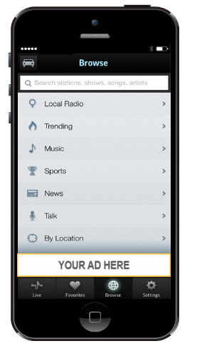
MOBILE TARGETING
Mock-Up Screenshot
Advertiser ::
Date ::
Site ::
Creative Size ::

Slide 4
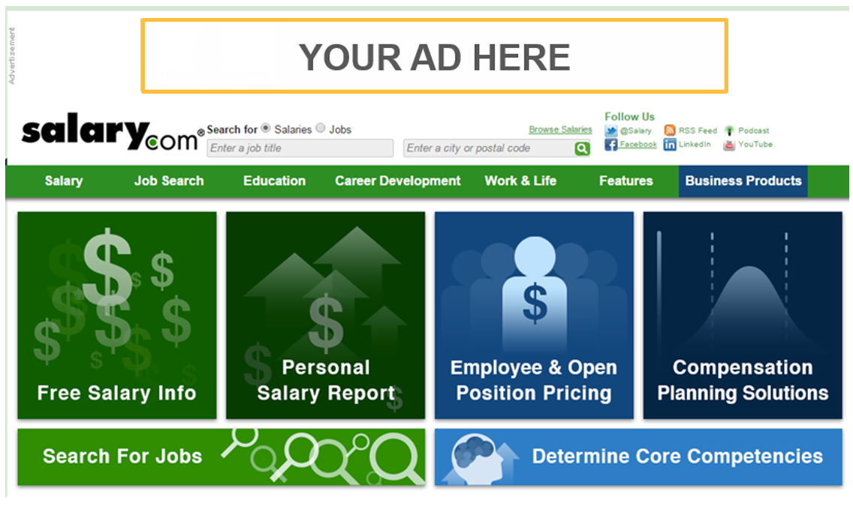
WEBSITE TARGETING
Mock-Up Screenshot
Advertiser ::
Date ::
Site ::
Creative Size ::

Slide 5
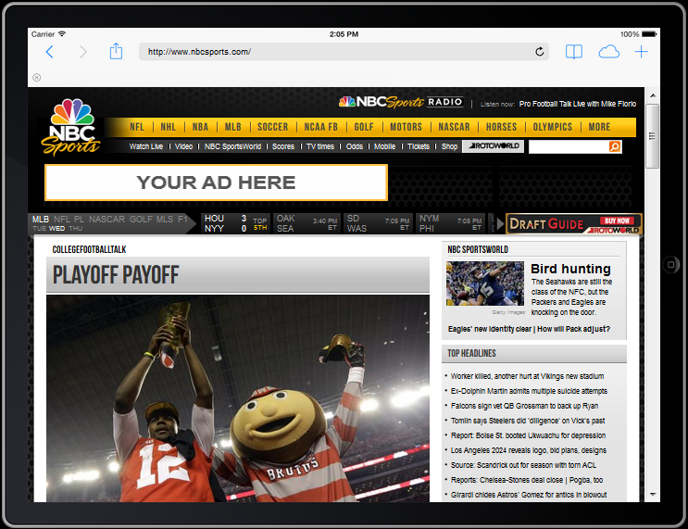
TABLET TARGETING
Mock-Up Screenshot
Advertiser ::
Date ::
Site ::
Creative Size ::

